Slide 1
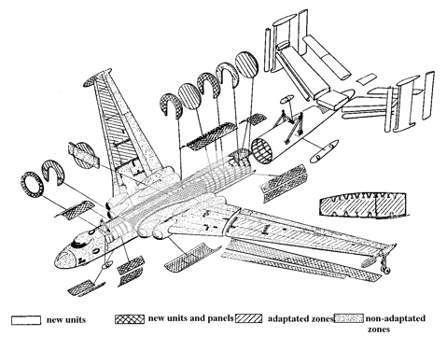
Function Approach

Slide 2
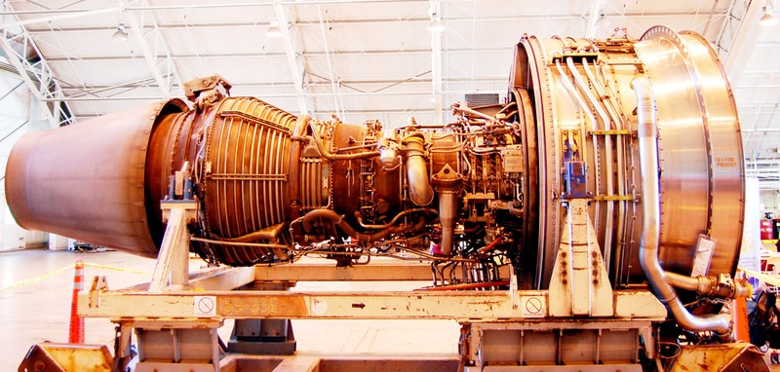



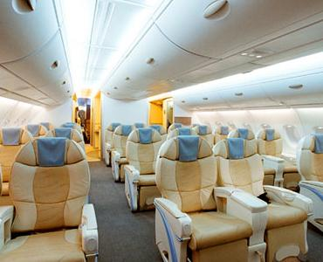

Test each function thoroughly, one at a time

Slide 3
Steps
Identify the program’s features / commands
Identify variables used by the functions and test their boundaries
Identify possible dependent variables
Use each function in a mainstream way and push it in as many ways as possible, as hard as possible
That’s Domain testing

Slide 4
Strength?
Thorough analysis of each item tested
Blind spots?
Misses feature interactions
Misses load-related issues, interaction with background tasks, effects of interrupts
Doesn’t address user tasks
4

Slide 5

Domain Approach

Slide 6

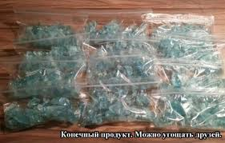
Equivalence Classes

Slide 7
Equivalence Classes
Two values are equivalent if the program would take the same path in response to each.
0
100

Slide 8
Steps
Identify variables
Identify dimensions
Define Borders (E.C.)
Select values

Slide 9
Strength?
Find highest probability errors with a relatively small set of tests.
Intuitively clear approach, generalizes well
Blind spots?
Errors that are not at boundaries or in obvious special cases.
Also, the actual domains are often unknowable
9

Slide 10

Scenario Testing
Challenging cases that reflect real use.
Appraise product against business rules, customer data, competitors’ output.
“Do something useful and interesting”
“Do one thing after another”

Slide 11
Scenario Testing Styles
User Approach
List of System Event
Mock business
Soap Operas

Slide 12


Strengths & Blind spots
Complex, realistic events. Can help with situations that are too complex to model.
Exposes failures that occur over time
Higher aggressiveness level of tests
May find design flaws
Single function failures can make this test inefficient.
Must think carefully to achieve good coverage.
Not efficient for regression
Hard to predict and control number of tests

Slide 13

Risk based testing

Slide 14
For Testing Purpose
It is important to know a way, the program could fail
And consequences of it’s failure for potential users

Slide 15


Slide 16

Results
Test | Risk | Severity | Description
Налить очень горячую жидкость | расплавится | critical | несколько раз сделать горячий чай в одном и том же стаканчике
Пить из стаканчика на большом морозе | потрескается | medium | поставить стаканчик в морозильную камеру на 1-2 дня
Положить что-нибудь тяжелое и поднять | отвалится дно | medium | держать стакан в руке и наливать большой поток жидкости с определенной высоты
Держать стаканчик мокрыми руками | не фиксируется в руке, неудобно держать, соскальзывает | medium | руки в креме, в масле
Стакан стоит на столе, наливать жидкость большим потоком | неустойчивость, возможность перевернуться | major | поставить стакан наполненный жидкостью на слегка неустойчивый стол и пошатать его,

Slide 17
Idea
Imagine how the product could fail
Design tests to expose these (potential) failures

Slide 18
Steps
Get Information
Identify Risks (Possible failures)
Do Test Design

Slide 19
Regression Testing

Slide 20

Some Statistics…
Functional Testing
Regression: 30% of all bugs
Automation: 15%
Manual:
85%
Other approaches
…
…

Slide 21
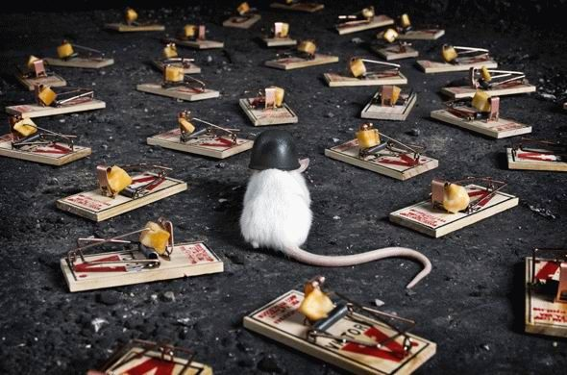
Application

Slide 22
Verification

Slide 23
Look around

Slide 24
Verification
Very quick
May be what customer requires
Not likely to find new bugs
Looking around
More bugs are found
“Random” bugs may be found
Takes more time
“Test cases” bug can be missed

Slide 25
Regression testing summary
Regression testing is good
Don’t forget about time and priorities
Time decreases with each pass
Automation can help in difficult situation
Create your own schedule
Create TCs for testing needs
Don’t be a fanatic!

Slide 26

Exploratory Testing

Slide 27
Questioning Similarity to previous errors Gossips and Predictions Improvisational Testing
Basic Exploratory Styles

Slide 28
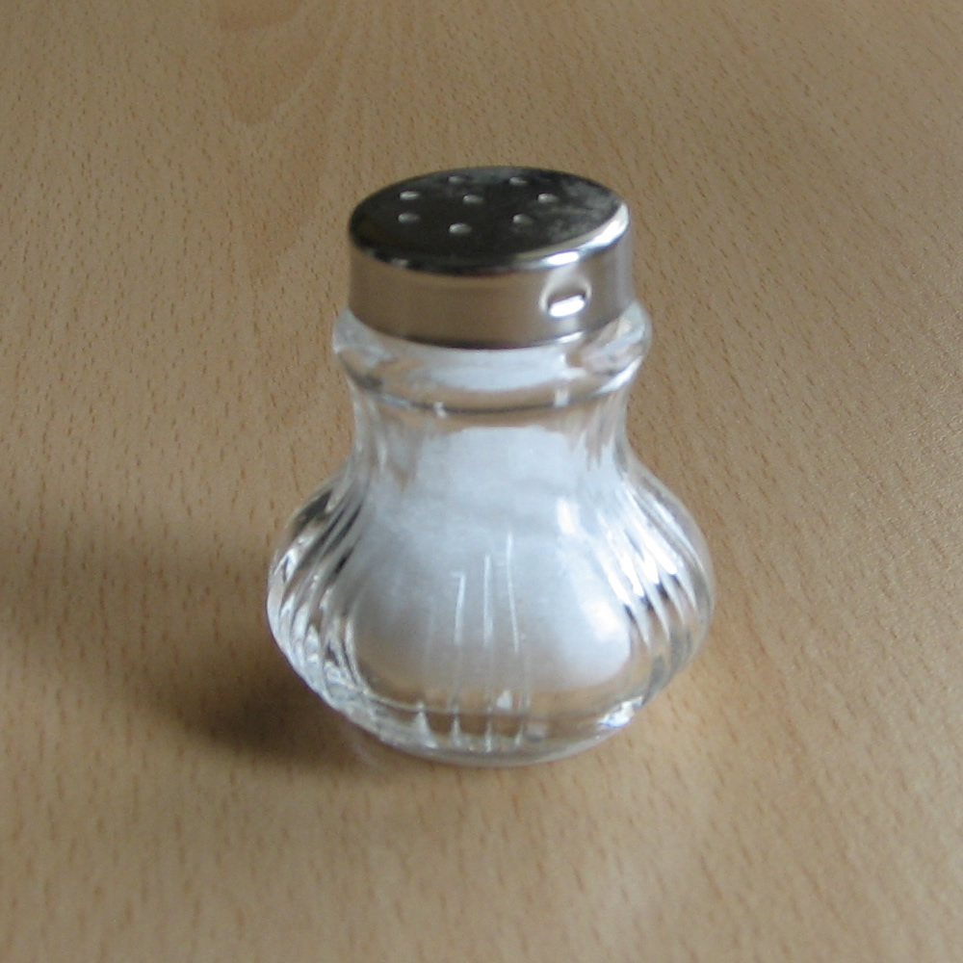

Slide 29

Bubbles Diagram
Соль не сыпется из солонки
Соль слишком крупная
Самый крупный сорт соли
Соли нет, но этого не видно
Соль слиплась
мокрая
Мокрые руки
Высокая влажость
Долго стояла

Slide 30

Strength

Slide 31

Blind Spots

Slide 32

All Pairs Testing

Slide 33
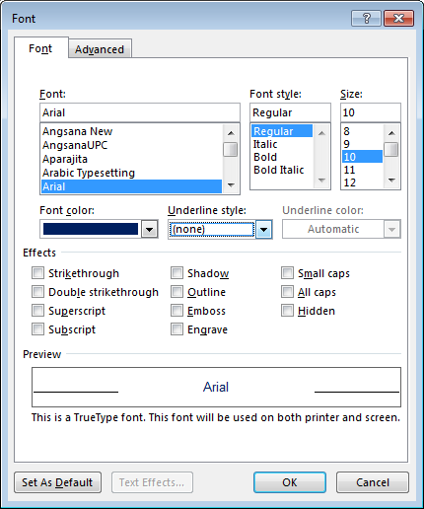
Parameters
Problem
Probability to have bugs with parameter combinations
Need to test combinations
How much cases?

Slide 34
Problem
2*4*3*3*2¹¹⁼ 147 456 тестов
Fonts: 2 (Times, Arial)
Styles: 4
Sizes: 3
Colors: 3 (black, white, some colored)
Effects: 11 parameters with 2 options

Slide 35

All pair testing
Quantity of tests: minimal
Difficulty: pretty easy
Bug catch possibility: Pretty high

Slide 36

Idea
Choose parameters
Choose parameter values
Build a table

Slide 37
15 тестов вместо 147456

Slide 38

Manually???

Slide 39

Nope, lol!!!
Use PICT!

Slide 40
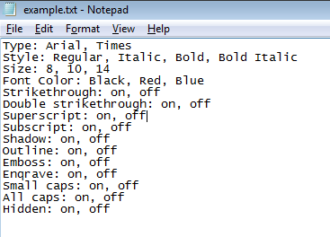
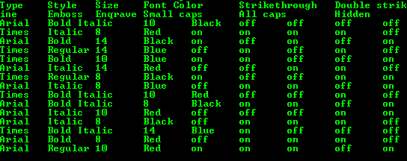
PICT, Example
pict “D:\All Pairs\example.txt”

Slide 41
Type | Style | Size | Font Color | Strikethrough | Double strikethrough | Superscript | Subscript | Shadow | Outline | Emboss | Enqrave | Small caps | All caps | Hidden
Arial | Bold Italic | 10 | Black | off | off | off | off | on | off | on | on | on | off | on
Times | Italic | 8 | Red | on | on | on | on | off | on | off | off | off | on | off
Arial | Bold | 14 | Black | on | off | on | off | on | on | on | off | on | on | off
Times | Regular | 14 | Blue | off | on | off | on | off | off | off | on | off | on | on
Times | Bold | 10 | Blue | on | on | off | off | on | on | off | on | off | off | off
Arial | Italic | 14 | Red | off | off | on | on | off | off | on | off | on | off | on
Times | Regular | 8 | Black | on | off | off | on | on | off | off | off | on | off | off
Arial | Italic | 8 | Blue | off | on | on | off | on | on | on | on | on | on | on
Times | Bold Italic | 10 | Red | off | off | on | off | off | on | on | off | off | on | off
Arial | Bold Italic | 8 | Black | on | on | off | on | off | on | off | on | off | on | on
Arial | Italic | 10 | Red | off | off | off | on | on | on | on | on | on | on | off
Arial | Italic | 8 | Black | off | on | on | on | off | off | off | off | off | off | off
Times | Bold Italic | 14 | Blue | on | off | off | off | off | off | on | off | on | on | on
Arial | Bold | 8 | Red | off | on | on | on | off | off | on | off | on | on | on
Arial | Regular | 10 | Red | on | on | on | off | on | on | on | off | on | off | on

Slide 42
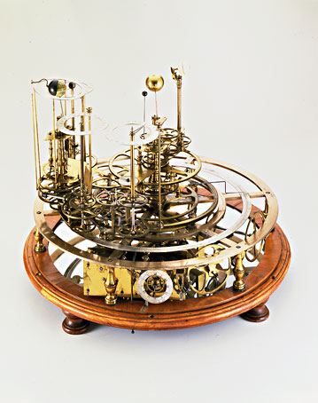
Testing Complex Logic

Slide 43
Trade Prefix Requirements
If the Trade Source is LSE then trade prefix shall be set to H
If the Trade Source is RTS then trade prefix shall be set to P
If the Trade Source is MICEX then trade prefix shall be set to X
If CP is ROLGP and Instrument is Local Equity then trade prefix shall be set to U
If the Instrument is Local Equity and if the trade source is RTS and the trade is not REPO and Listing is not 'GTS' and trade is not client trade (LORO Account is empty) and (T_RTS_Trades.InitPair or T_RTS_Trades.ConfPair)!=resecpl then set prefix to U.
If Instrument is Local Equity and settlement currency is RUR and the LORO Account is empty and the Counterparty is not exchange and does not have Entity Trades scheme set to (RESEC 2006 and RCS&RCL local client) then trade prefix shall be set to U.
If the Instrument is Local Equity and if the trade source is 'RTS' and the trade is not REPO and t_rts_trades.tradetype=A and settlement currency is RUR and Listing is not 'GTS' then set prefix to U.
If the Instrument has Type equal to Currency Pair then set prefix to 'Y'.
If the Instrument has ADR or Foreign Equity subtype then the Trade Prefix shall be set to the first letter of the Trade Code of the Counterparty.
If the Instrument is Local Equity and if the trade source is 'Micex' or 'RTS' and the trade is not REPO and (((t_Micex_trades.Account is ' ' or t_Micex_trades.Account is 'RENBR') and t_Micex_trading_Broker is 'RENBR') or (t_rts_trades.InitPair or t_rts_trades.ConfPair is 'renbrsg')) the set prefix to 'G'
If the Instrument has Local Equity subtype or PIF subtype and the Counterparty has Entity Trades Scheme set to RCS&RCL Local Client then the trade prefix shall be set to the first letter of the Trade Code of the Counterparty.
….

Slide 44
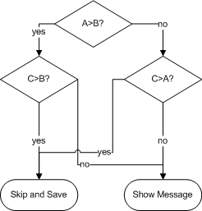
The method
Нарисовать требование в виде графа\блок схемы
Выбрать достаточно путей, чтобы покрыть все связи ( не все возможные пути!)
Выбрать нужные входные значения
Подать значения на вход, проверить выход.
1
2
3
4
1: 5, 3, 4 – skip and save
2: 5, 4, 3 – show message
3: 4, 5, 5 – skip and save
4: 4, 5, 3 – show message
Passed
Failed
Passed
Passed

Slide 45
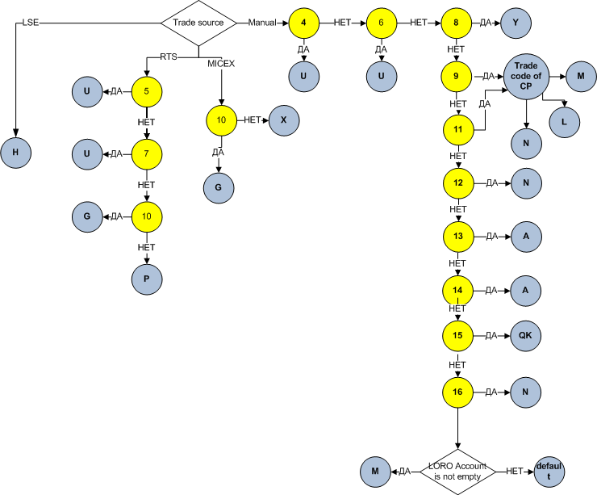
Answer

